Slide 1

Azure DevOps
Name
Title

Slide 2




Azure DevOps
#AzureDevOps
https://azure.com/devops
@AzureDevOps
https://aka.ms/AzureDevOpsForum
https://aka.ms/DevOpsBlog/
Notes:
Join the conversation.
Potentially replace for speaker contact details / intro.

Slide 3
What is DevOps?
People. Process. Products.
Build& Test
Deploy
DevOps is the union of people, process, and products to enable continuous delivery of value to your end users.
“
Continuous Delivery
Develop
Operate
”
Plan & Track
Monitor & Learn
Notes:
DevOps is the union of people, process and products to enable the continuous delivery of value to your end customers

Slide 4


High Performance DevOps Companies Achieve…
46x Deployment
Frequency
2,555x Faster Lead
Time For Changes
Faster
Time to Market
DevOps
$
Increased
Revenue
7x Lower Change
Failure Rate
2,604x Faster Mean
Time to Recover
Source: 2018 Accelerate: State of DevOps: Strategies for a New Economy." N. Forsgren, J. Humble, G. Kim. DevOps Research and Assessment (DORA)

Slide 5
How Microsoft can help
Microsoft Azure is a powerful and flexible foundation for past, present, and future apps – easily build, manage, and deploy any application and any stack on a massive, global network using your favorite tools and frameworks.
Flexible
Powerful
Open
Choice of IaaS, PaaS, public cloud or hybrid.
Mirror or modernize app infrastructure with VMs, containers, microservices or serverless.
Supports all stages of the app modernization journey – from lift-and-shift to Cloud-Native.
Instantly improve the performance, scalability and resiliency of your apps by moving them to the cloud.
Increase business agility with Cloud-Native capabilities and built-in DevOps for continuous innovation.
Bring your stack, we bring a cloud that runs any app, on any platform, and any language.
Build applications using the language and tools of your choice - Azure supports what you already use and love so you can get up and running fast – just bring code.

Slide 6
What technologies do I need to support DevOps?
DevOps brings together people, processes, and technology, automating software delivery to provide continuous value to your users. Using Azure DevOps, you can deliver software faster and more reliably - no matter how big your IT department or what tools you’re using.
Continuous Integration (CI)
Improve software development quality and speed.
When you use Azure Pipelines or Jenkins to build apps in the cloud and deploy to Azure, each time you commit code, it’s automatically built and tested and bugs are detected faster.
Continuous Deployment (CD)
By combining continuous integration and infrastructure as code (IaC), you’ll achieve identical deployments and the confidence to deploy to production at any time.
With continuous deployment, you can automate the entire process from code commit to production if your CI/CD tests are successful.
Continuous Learning & Monitoring
With Azure Application Insights you can identify how your applications are performing and test if the recent deployment made things better or worse.
Using CI/CD practices, paired with monitoring tools, you’ll be able to safely deliver features to your customers as soon as they’re ready.

Slide 7





Introducing Azure DevOps
Azure Boards
Azure Pipelines
Azure Repos
Deliver value to your users faster using proven agile tools to plan, track, and discuss work across your teams.
Build, test, and deploy with CI/CD that works with any language, platform, and cloud. Connect to GitHub or any other Git provider and deploy continuously.
Get unlimited, cloud-hosted private Git repos and collaborate to build better code with pull requests and advanced file management.
Azure Test Plans
Azure Artifacts
➔
Test and ship with confidence using manual and exploratory testing tools.
Create, host, and share packages with your team, and add artifacts to your CI/CD pipelines with a single click.
https://azure.com/devops
Notes:
So does TFS

Slide 8

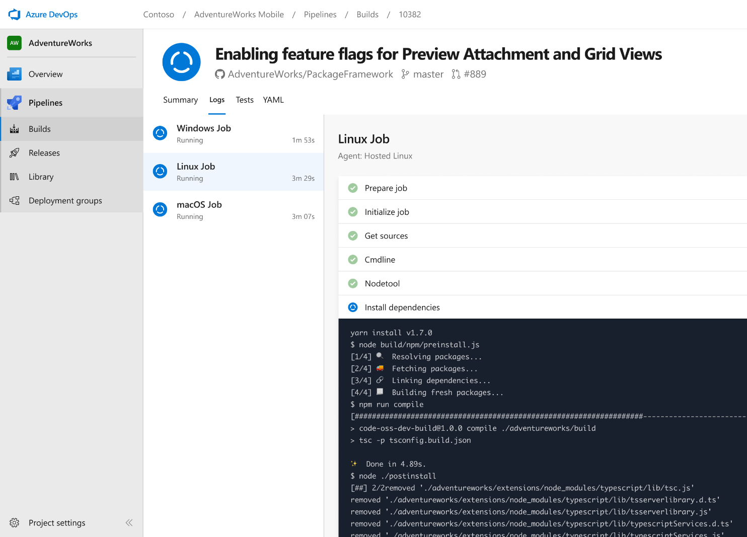


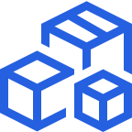

Azure Pipelines
Cloud-hosted pipelines for Linux, Windows and macOS, with unlimited minutes for open source
Any language, any platform, any cloud
Build, test, and deploy Node.js, Python, Java, PHP, Ruby, C/C++, .NET, Android, and iOS apps. Run in parallel on Linux, macOS, and Windows. Deploy to Azure, AWS, GCP or on-premises
Extensible
Explore and implement a wide range of community-built build, test, and deployment tasks, along with hundreds of extensions from Slack to SonarCloud. Support for YAML, reporting and more
Containers and Kubernetes
Easily build and push images to container registries like Docker Hub and Azure Container Registry. Deploy containers to individual hosts or Kubernetes.
Best-in-class for open source
Ensure fast continuous integration/continuous delivery (CI/CD) pipelines for every open source project. Get unlimited build minutes for all open source projects with up to 10 free parallel jobs across Linux, macOS and Windows
➔
https://azure.com/pipelines
Notes:
Azure Pipelines is the perfect launchpad for your code – automating your builds and deployments so you spend less time with the nuts and bolts and more time being creative

Slide 9

“Judge us by the actions we have taken in the recent past, our actions today and in the future”
—Satya Nadella, CEO Microsoft
2012
2018

Slide 10

Microsoft Open Source
2018
Visual Studio Code ranked #1 developer tool
Azure Service Fabric Open Sourced
Azure Sphere with Linux kernel
Intent to acquire GitHub announced
~5,000 Microsoft employees committing to open source projects on GitHub
Azure trending to 50% Linux
Microsoft continues as largest contributor to open source projects on GitHub
“Judge us by the actions we have taken in the recent past, our actions today and in the future”
—Satya Nadella, CEO Microsoft
2017
Microsoft Azure Kubernetes Service launched
Draft, Brigade, Kashti projects submitted to Kubernetes community
Microsoft joins Cloud Native Computing & Cloud Foundry Foundations
SQL 2017 on Linux
Windows source code moved to Git
Azure Databricks (Apache Spark) announced
2016
.NET Core 1.0
PowerShell Core
Windows Subsystem for Linux in Windows 10
Microsoft joins Linux Foundation
GitHub recognizes Microsoft as a top open source contributor
2015
Visual Studio Code released
HDInsight (Hadoop/ Ubuntu) announced
Microsoft jointly forms Node.js foundation
2014
Satya “Microsoft loves Linux”
Microsoft org on GitHub created
.NET Foundation created
2012
TypeScript released
Git support added to TFS and Visual Studio
2012
2014
2015
2016
2017
2018
Notes:
& at Microsoft we love open source.
First OSS project was in 2004 when the Windows Installer Toolkit (WiX) was released to SourceForge.
Started contributing to the Linux kernel in 2009
Every year we do more & more in the open source realm.
How we embrace the projects the community has embraced… from Linux to Kubernetes.
One of the ones I was deeply involved in was whether to compete with Git or become part of it. Today most of MS development is done in Git. The source control system that Linux created.
Including Windows. Think about that for a second, the Windows team use the source control system written by Linus Torvalds.
Or the ways we increasingly open source the software we work on… from .NET to VS Code & TypeScript. In fact, much of the core tech in Azure Pipelines itself is open source
Transition:
This week we are adding to this list of giving to open source…

Slide 11

Azure Pipelines
Microsoft Open Source
Free unlimited build minutes for public projects
Up to 10 free parallel jobs across Windows, Linux and macOS
➔
https://azure.com/pipelines
Notes:
All the builds you need, using the power of Azure you get one service that gives you unlimited build minutes where you can build on Windows Mac and Linux in parallel using a single build YAML file.

Slide 12

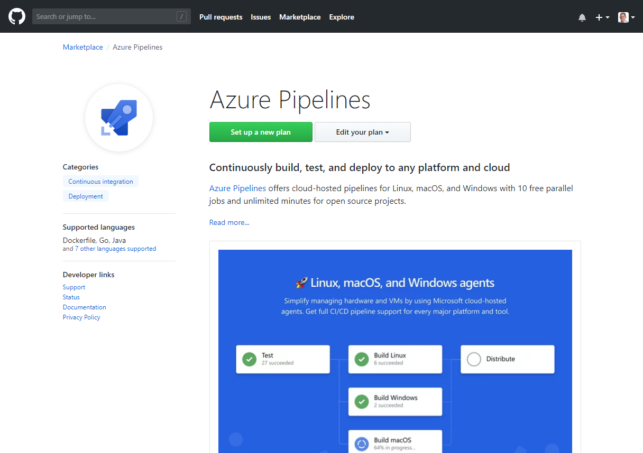
Integrated with GitHub
Azure Pipelines available now to any developer from the GitHub Marketplace

Slide 13
Azure DevOps
Azure Boards
Azure Pipelines
Azure Repos
Deliver value to your users faster using proven agile tools to plan, track, and discuss work across your teams.
Build, test, and deploy with CI/CD that works with any language, platform, and cloud. Connect to GitHub or any other Git provider and deploy continuously.
Get unlimited, cloud-hosted private Git repos and collaborate to build better code with pull requests and advanced file management.
Azure Test Plans
Azure Artifacts
➔
Test and ship with confidence using manual and exploratory testing tools.
Create, host, and share packages with your team, and add artifacts to your CI/CD pipelines with a single click.
https://azure.com/devops
Notes:
So does TFS

Slide 14

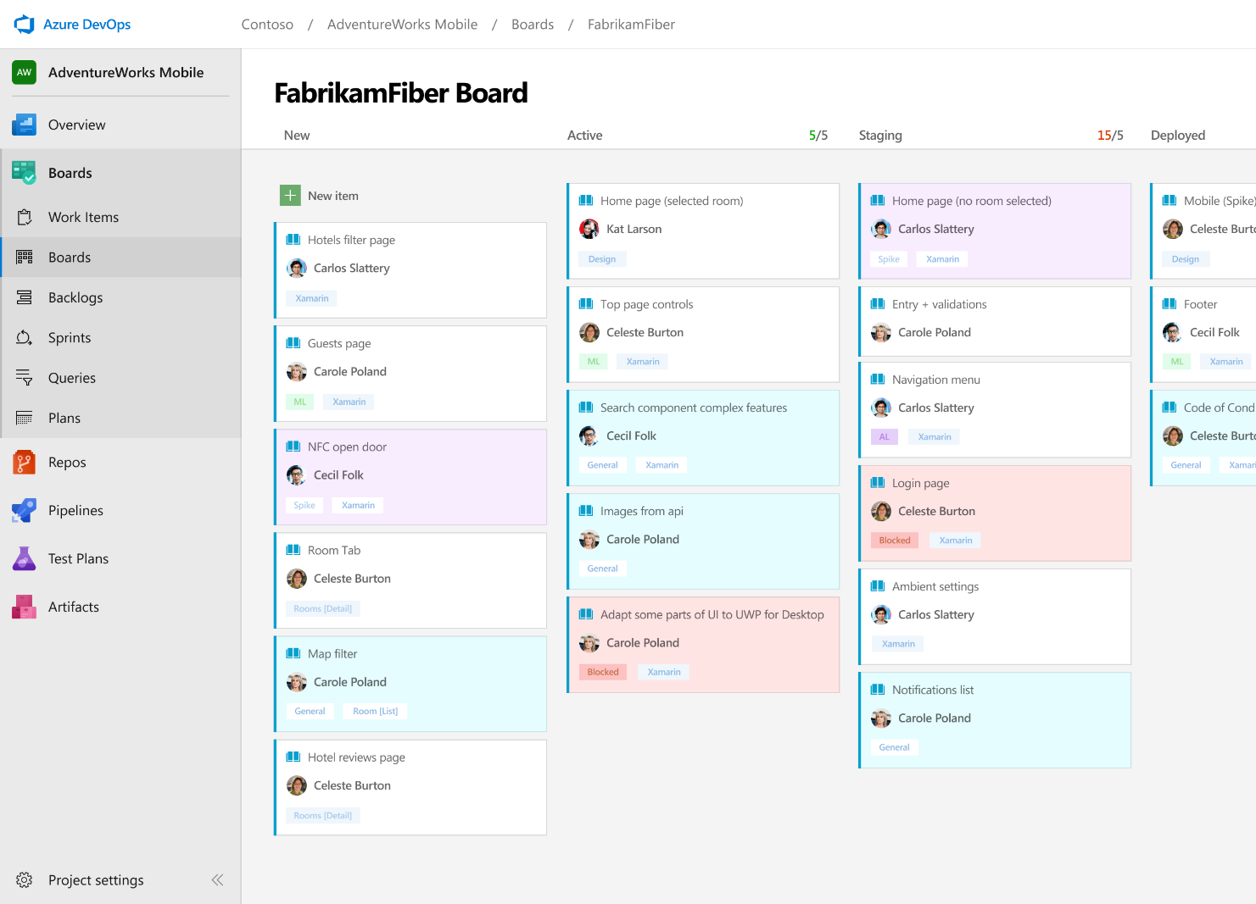



Azure Boards
Track work with Kanban boards, backlogs, team dashboards, and custom reporting
Connected from idea to release
Track all your ideas at every development stage and keep your team aligned with all code changes linked directly to work items.
Scrum ready
Use built-in scrum boards and planning tools to help your teams run sprints, stand-ups, and planning meetings.
Project insights
Gain new insights into the health and status of your project with powerful analytics tools and dashboard widgets.
➔
https://azure.com/devops
Notes:
Combine Kanban boards and drag-and-drop sprint planning with comprehensive traceability and reporting for the perfect home for all your ideas–big and small.

Slide 15
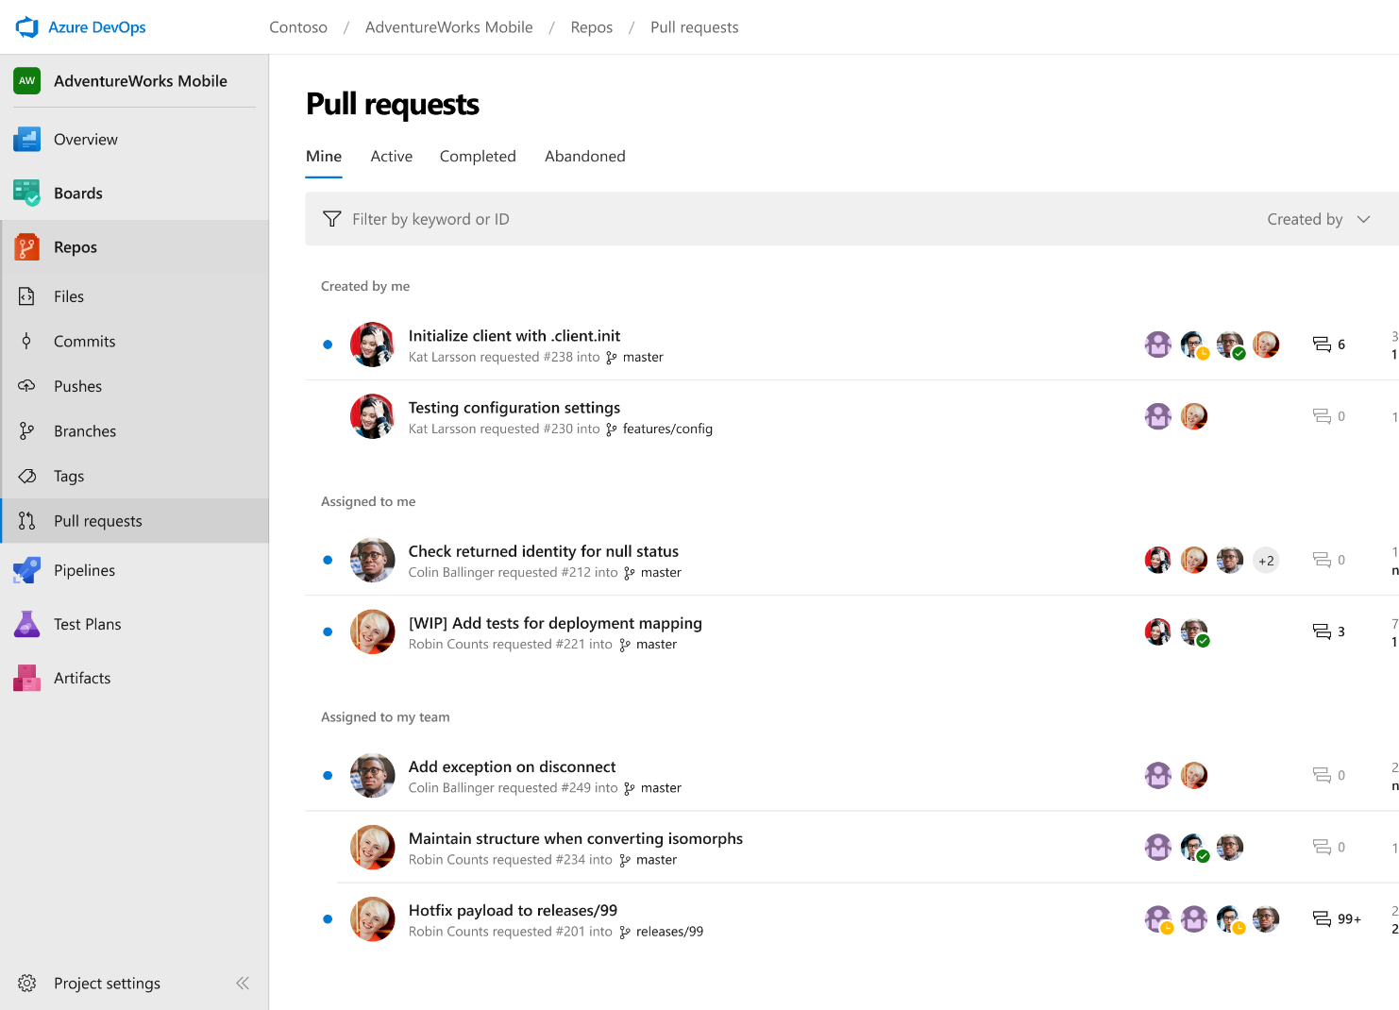



Azure Repos
Unlimited private Git repo hosting and support for TFVC that scales from a hobby project to the world’s largest Git repositories
Works with your Git client
Securely connect with and push code into your Git repos from any IDE, editor, or Git client.
Web hooks and API integration
Add validations and extensions from the marketplace or build your own using web hooks and REST APIs.
Semantic code search
Quickly find what you’re looking for with code-aware search that understands classes and variables.
➔
https://azure.com/devops
Notes:
Collaborate on code changes with threaded discussion and continuous integration for each change. Use forks to promote collaboration with Inner Source workflows.

Slide 16
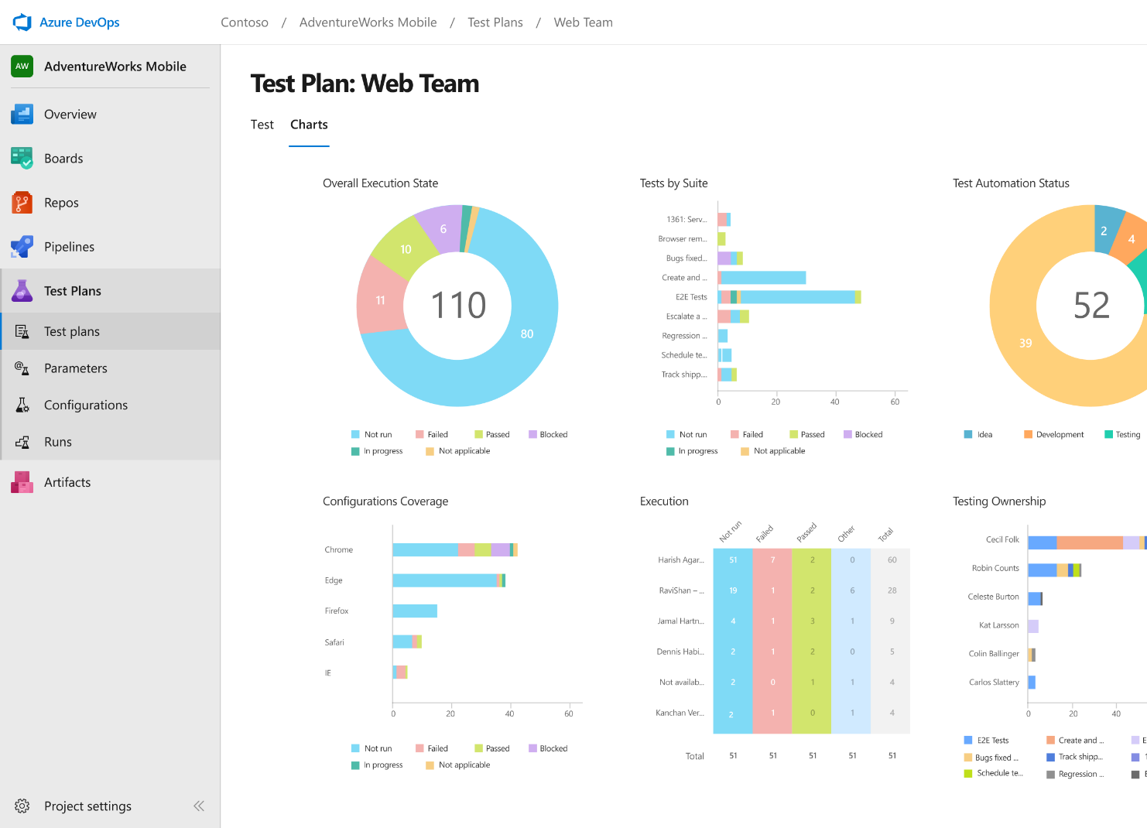
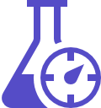


Azure Test Plans
Get end-to-end traceability. Run tests and log defects from your browser. Track and assess quality throughout your testing lifecycle.
Capture rich data
Capture rich scenario data as you execute tests to make discovered defects actionable. Explore user stories without test cases or test steps. You can create test cases directly from your exploratory test sessions.
Test across web and desktop
Test your application where it lives. Complete scripted tests across desktop or web scenarios. Test on-premises application from the cloud and vice-versa.
Get end-to-end traceability
Leverage the same test tools across your engineers and user acceptance testing stakeholders. Pay for the tools only when you need them.
➔
https://azure.com/devops
Notes:
Collaborate on code changes with threaded discussion and continuous integration for each change. Use forks to promote collaboration with Inner Source workflows.

Slide 17
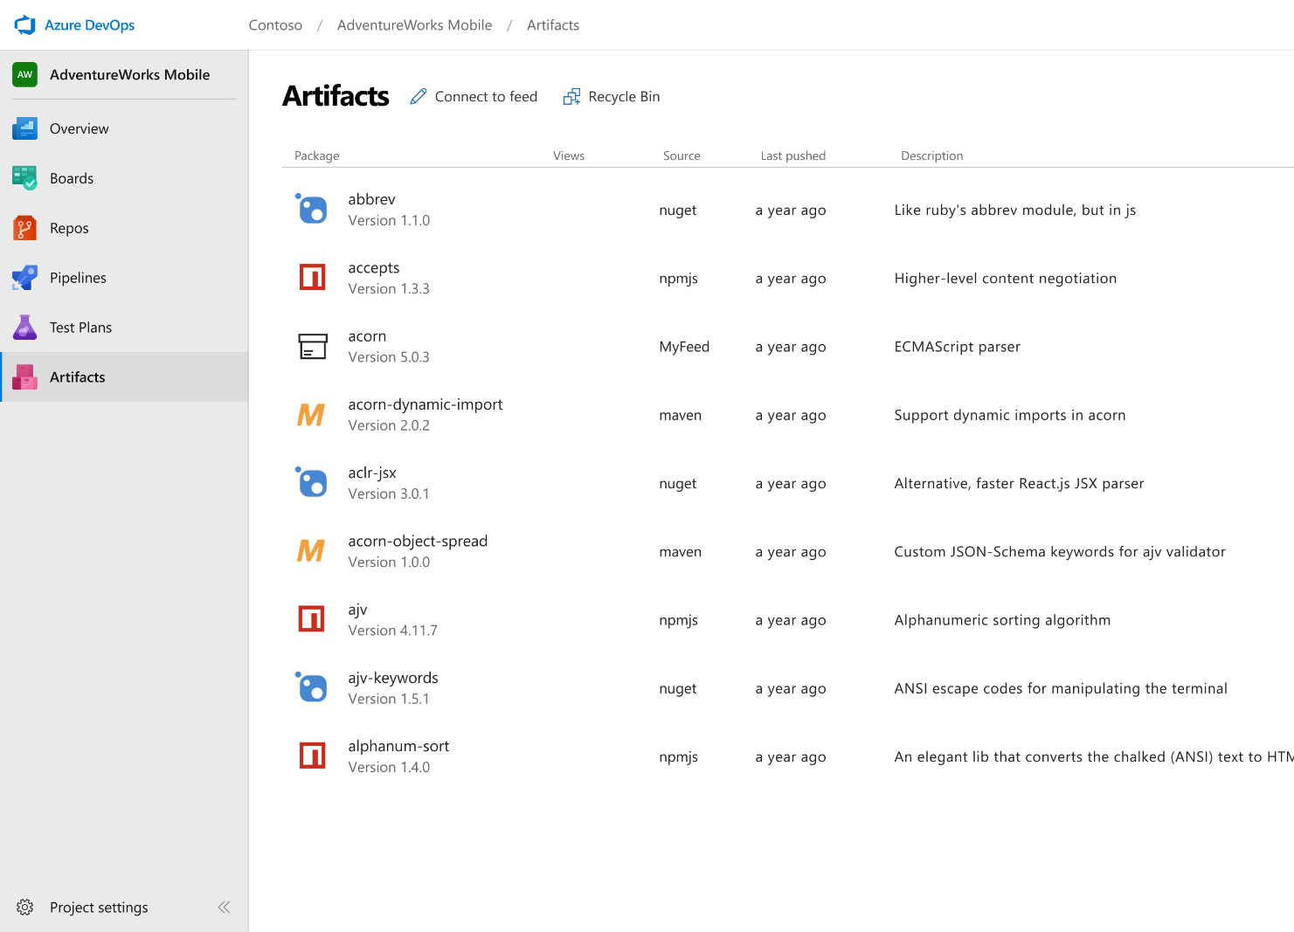



Azure Artifacts
Create and share Maven, npm, and NuGet package feeds from public and private sources – fully integrated into CI/CD pipelines
Manage all package types
Get universal artifact management for Maven, npm, and NuGet.
Add packages to any pipeline
Share packages, and use built-in CI/CD, versioning, and testing.
Share code efficiently
Easily share code across small teams and large enterprises.
➔
https://azure.com/devops
Notes:
Collaborate on code changes with threaded discussion and continuous integration for each change. Use forks to promote collaboration with Inner Source workflows.

Slide 18
Azure DevOps
#AzureDevOps
Demo
Speaker Name

Slide 19
Azure DevOps
Better together
Azure Boards
Azure Repos
Azure Pipelines
Azure Test Plans
Azure Artifacts
An end-to-end solution for organizations looking for an enterprise-grade toolchain
Fully Integrated with end to end traceability
Scalable to any team and project size
Highly available, multi region, hybrid cloud & on-prem
Customer Support
Consistent admin and access control
➔
https://azure.com/devops

Slide 20






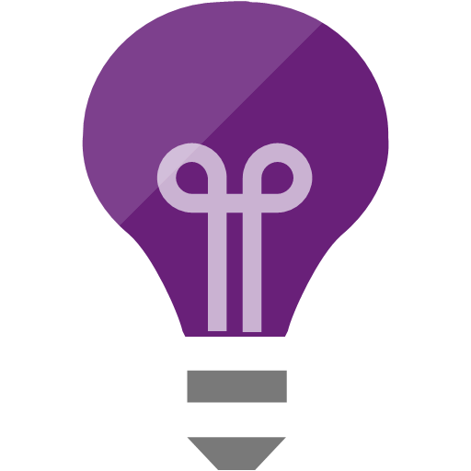

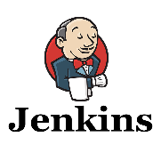
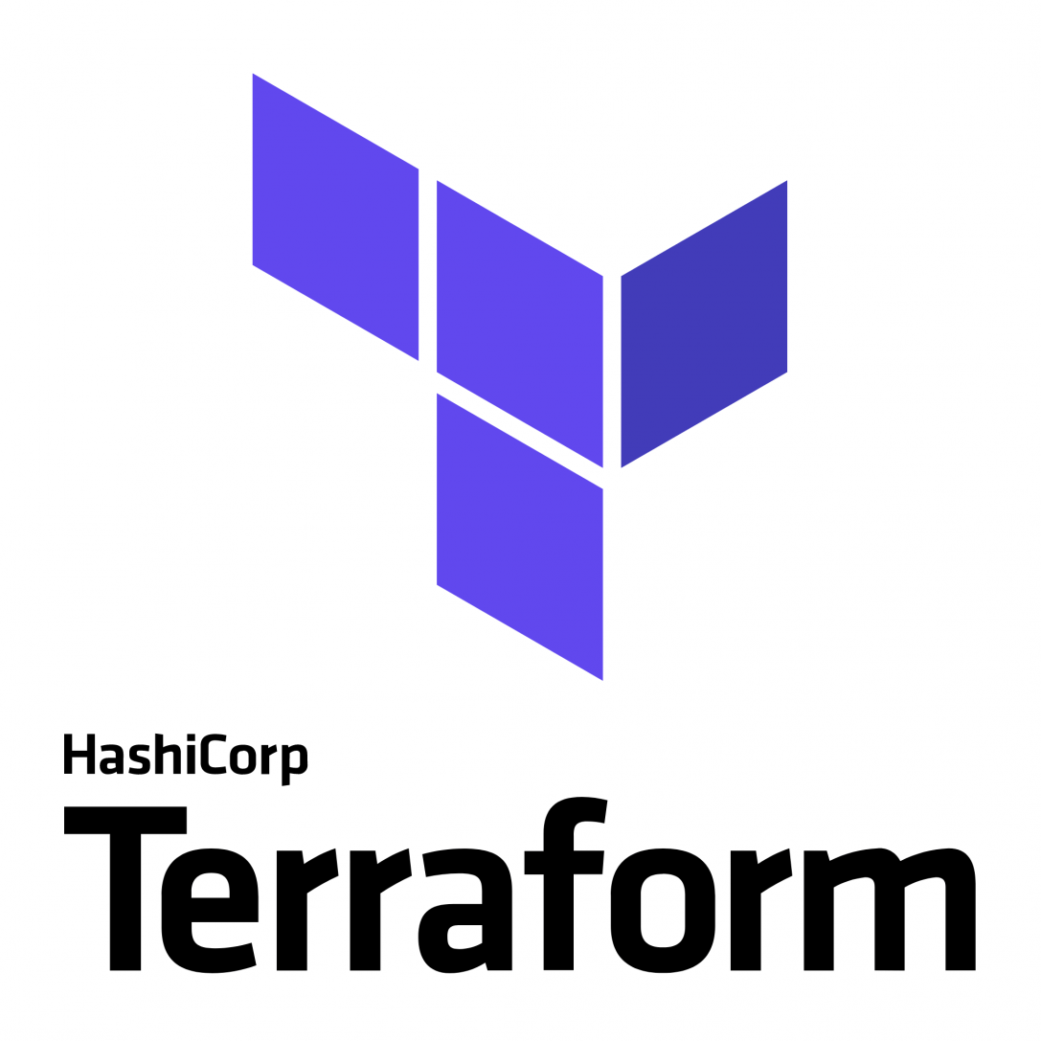
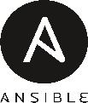


Broadening the Azure Ecosystem
Notes:
So does TFS

Slide 21









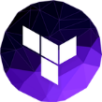
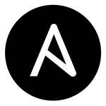
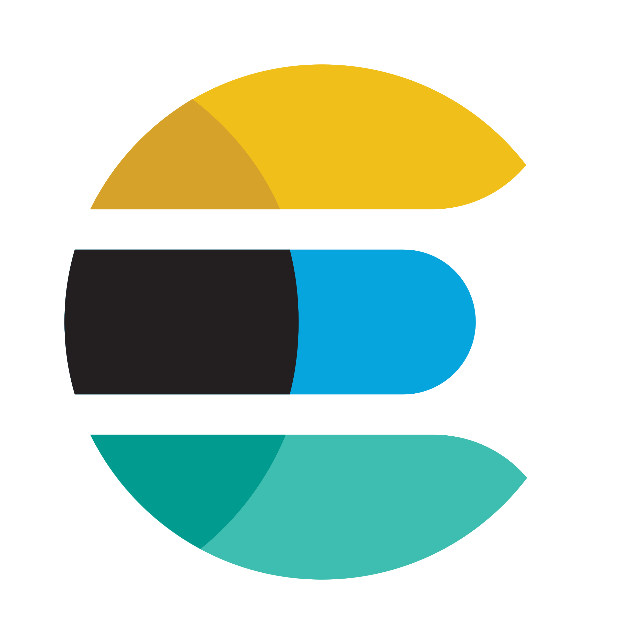

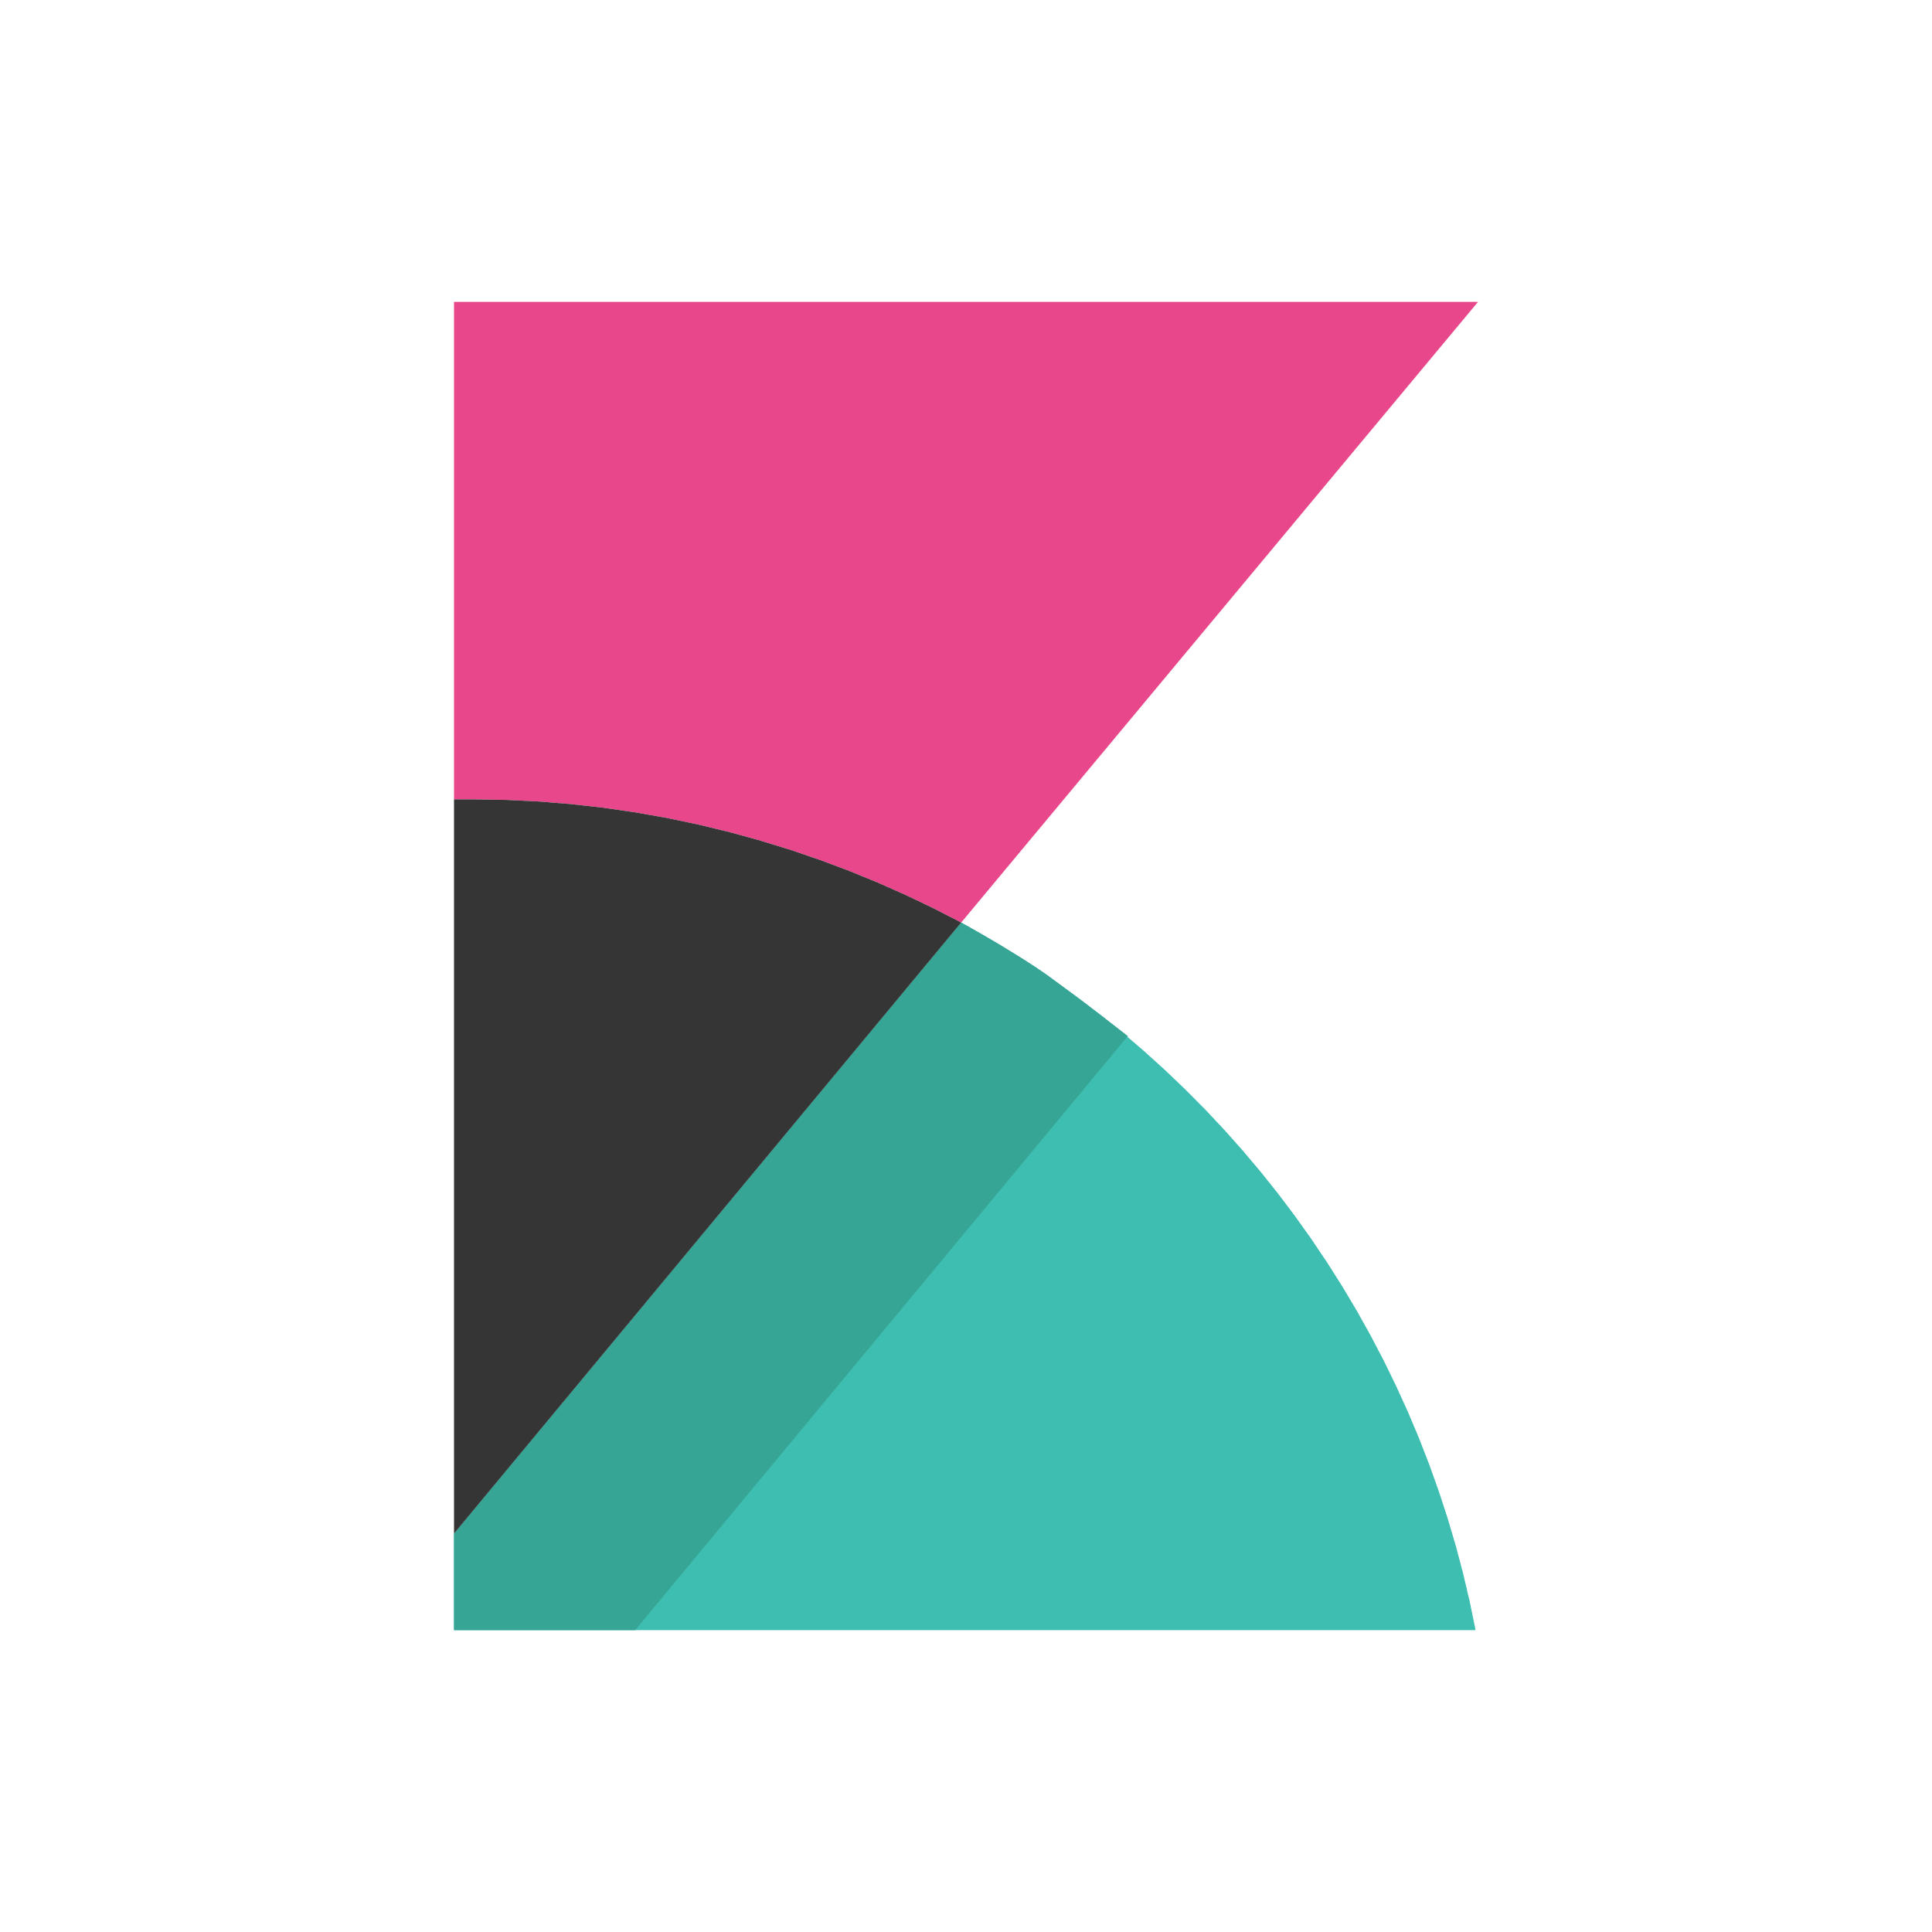
DevOps on Azure framework
Plan and track
Code
Build and test
Deploy
Operate
Monitor
Boards
(Azure DevOps)
Repos
(Azure DevOps)
Pipelines & Test Plans
(Azure DevOps)
Artifacts & Pipelines
(Azure DevOps)
Policy
Application
Insights
GitHub
Trello
GitHub
Jenkins
Terraform
Ansible
ELK Stack
Notes:
Deliver continuous innovation faster and more reliably with DevOps and Microsoft Azure.
Azure DevOps provides a fully integrated set of enterprise DevOps services covering the entire DevOps lifecycle. You can use all the Azure DevOps services, or choose just what you need to complement your existing workflows. Azure DevOps is comprised of:
Azure Boards allows you to track work with configurable Kanban boards, interactive backlogs, and powerful planning tools. Combined with the Azure DevOps suite of services, it provides traceability through the entire pipeline, from work item tracking, to code commit, builds and right through deployments.
Azure Repos provide flexible and powerful Git hosting with effective code reviews, start free and scale to unlimited git repositories for all your ideas.
Azure Pipelines allows you to build, test and deploy in any language, to any cloud – or on-premises. Run builds and tests in parallel on Linux, macOS, or Windows, and deploy containers to individual hosts or Kubernetes
Azure Test Plans enables you to improve your overall code quality with manual and exploratory testing tools for your apps.
Azure Artifacts allows you to share Maven, npm, and NuGet packages from public and private sources with your entire team. Integrate package sharing into your CI/CD pipelines in a way that's simple and scalable.
You can also use GitHub Enterprise or GitHub Business cloud for the management of source code, with direct integration into Azure Pipelines to provide an end-to-end solution that leverages the power and familiarity of GitHub, the largest open source community in the world. GitHub is also an open platform supporting a large ecosystem of integrations beyond Azure, that are easily available from the GitHub marketplace.
Azure is open – so If you've already made tooling choices such as Jenkins, Terraform, Ansible or Chef, we provide clear guidance and documentation to help you get started on Azure, fast.
If you’ve made choices in some areas, but have gaps in others, you can take advantage of Azure Pipelines to orchestrate and supplement your end-to-end DevOps toolchain.
Regardless of your toolchain choice, take advantage of the reliable and integrated security, monitoring & management capabilities of the Azure platform such as Azure Policy, Azure Monitor and Application Insights – spend less time fighting fires and more time meeting business requirements

Slide 22
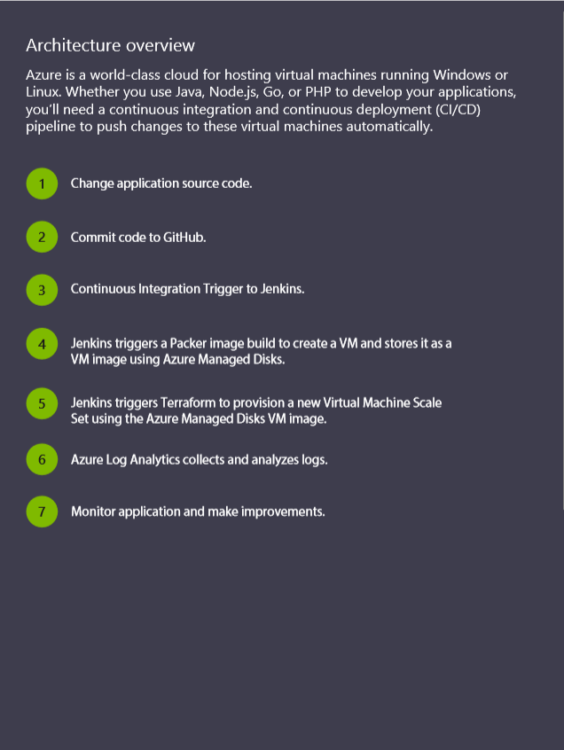
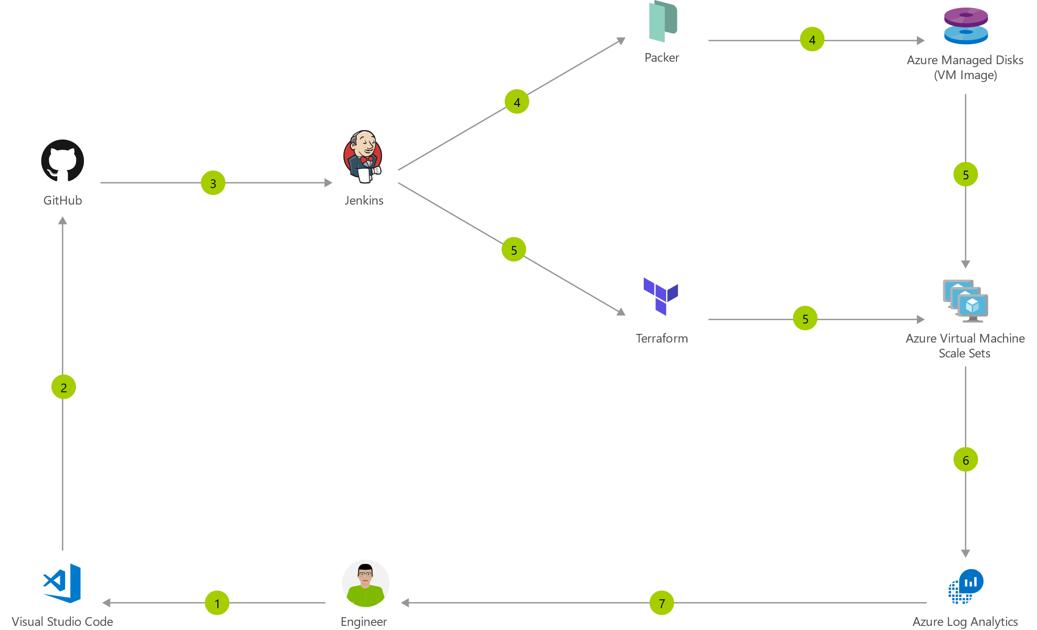
Immutable Infrastructure CI/CD using Jenkins and Terraform on Azure Virtual Machine Scale Sets
Notes:
https://azure.microsoft.com/en-us/solutions/architecture/immutable-infrastructure-cicd-using-jenkins-and-terraform-on-azure-virtual-architecture-overview/

Slide 23
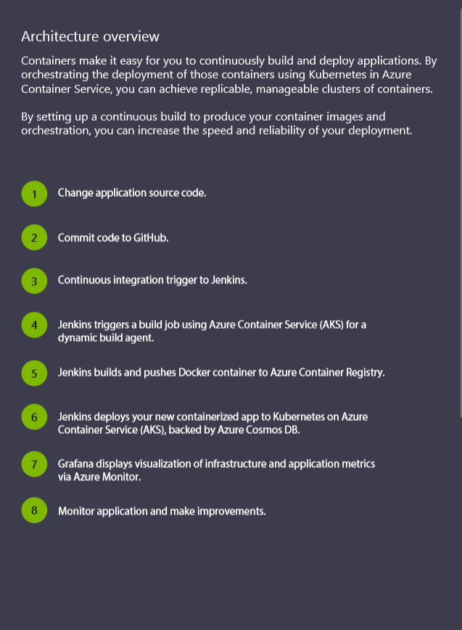
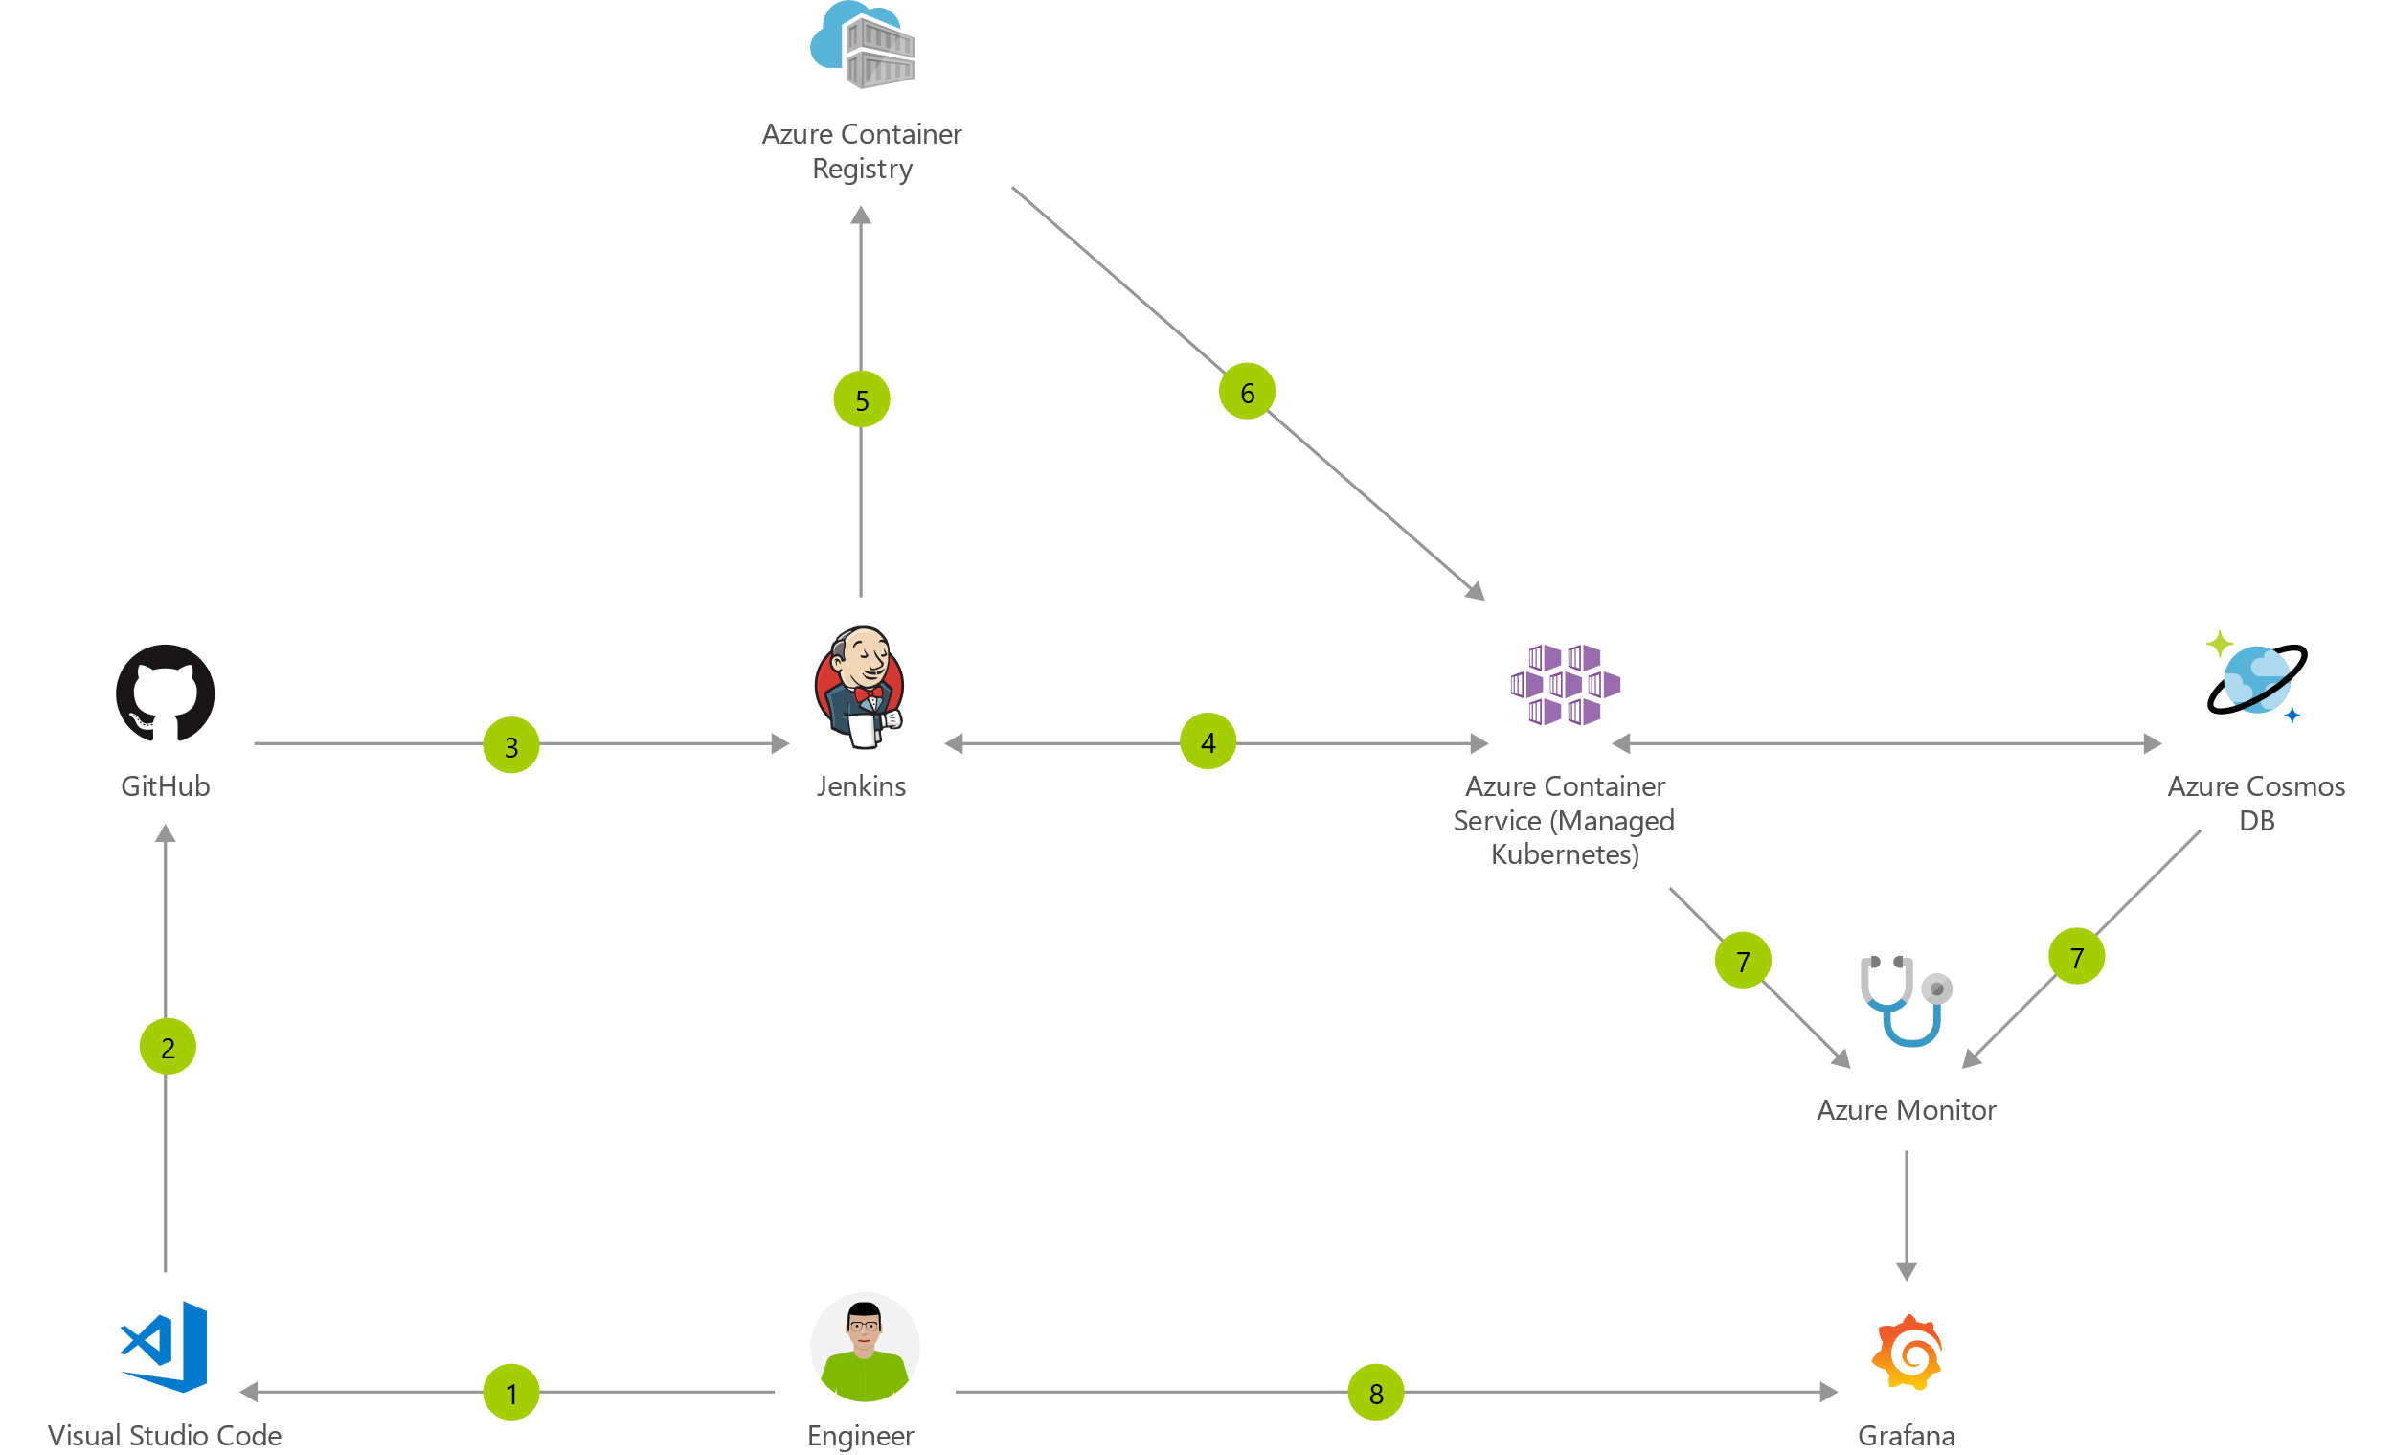
Container CI/CD Using Jenkins and Kubernetes on Azure Container Service (AKS)
Notes:
https://azure.microsoft.com/en-us/solutions/architecture/container-cicd-using-jenkins-and-kubernetes-on-azure-container-service/

Slide 24
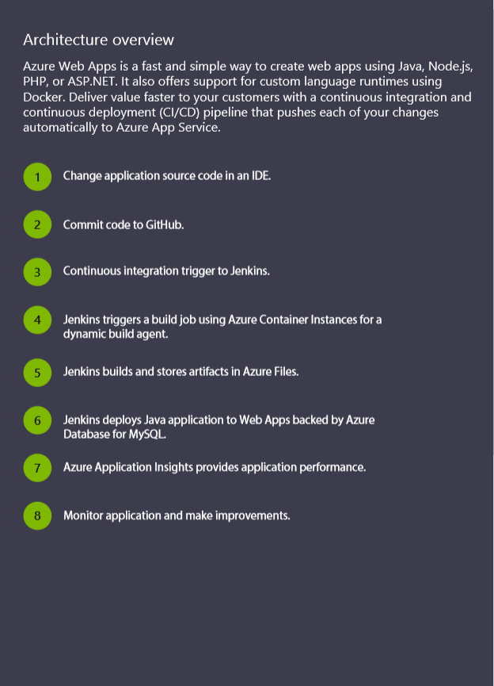
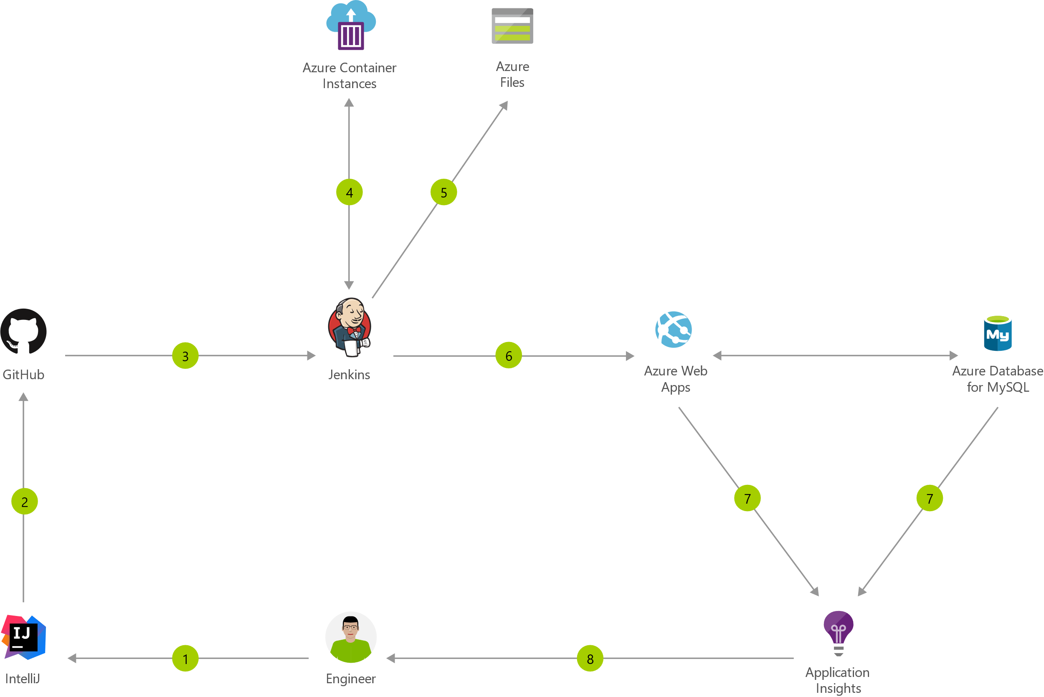
Java CI/CD using Jenkins and Azure Web Apps
Notes:
https://azure.microsoft.com/en-us/solutions/architecture/java-cicd-using-jenkins-and-azure-web-apps/

Slide 25

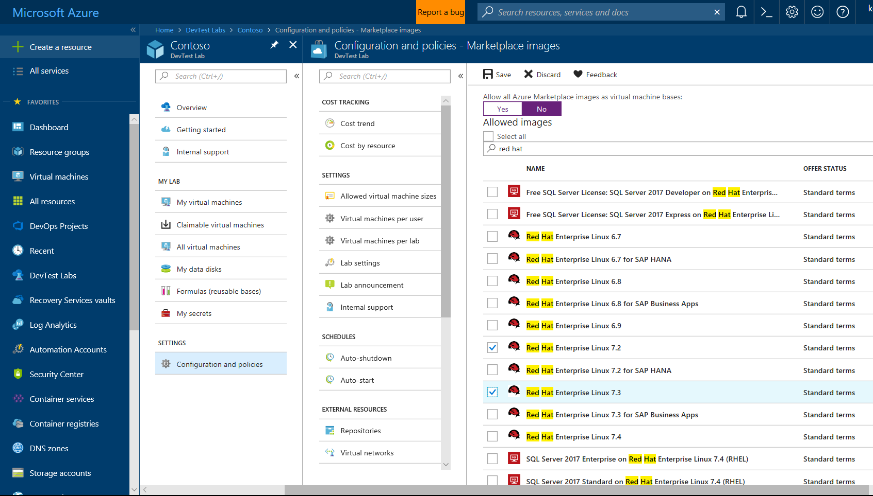
Self-Service Dev/Test Environments
Azure Lab Services
Simplify cloud environment management for developers and testers.
Enforce policies and control costs with full visibility
Use templates, custom images and formulas to reproduce environments.
Orchestrate with Azure Pipelines or integrate using REST API
Notes:
Whether you’ve already started implementing DevOps or looking to get started, a common challenge is for IT organizations is keeping up with project demand for development and test environments
DevTest Labs simplifies environment management for Dev & Test environments in the Azure cloud
Provide self-service access for teams, with policies to control cost and enforce use of appropriate images and artifacts

Slide 26
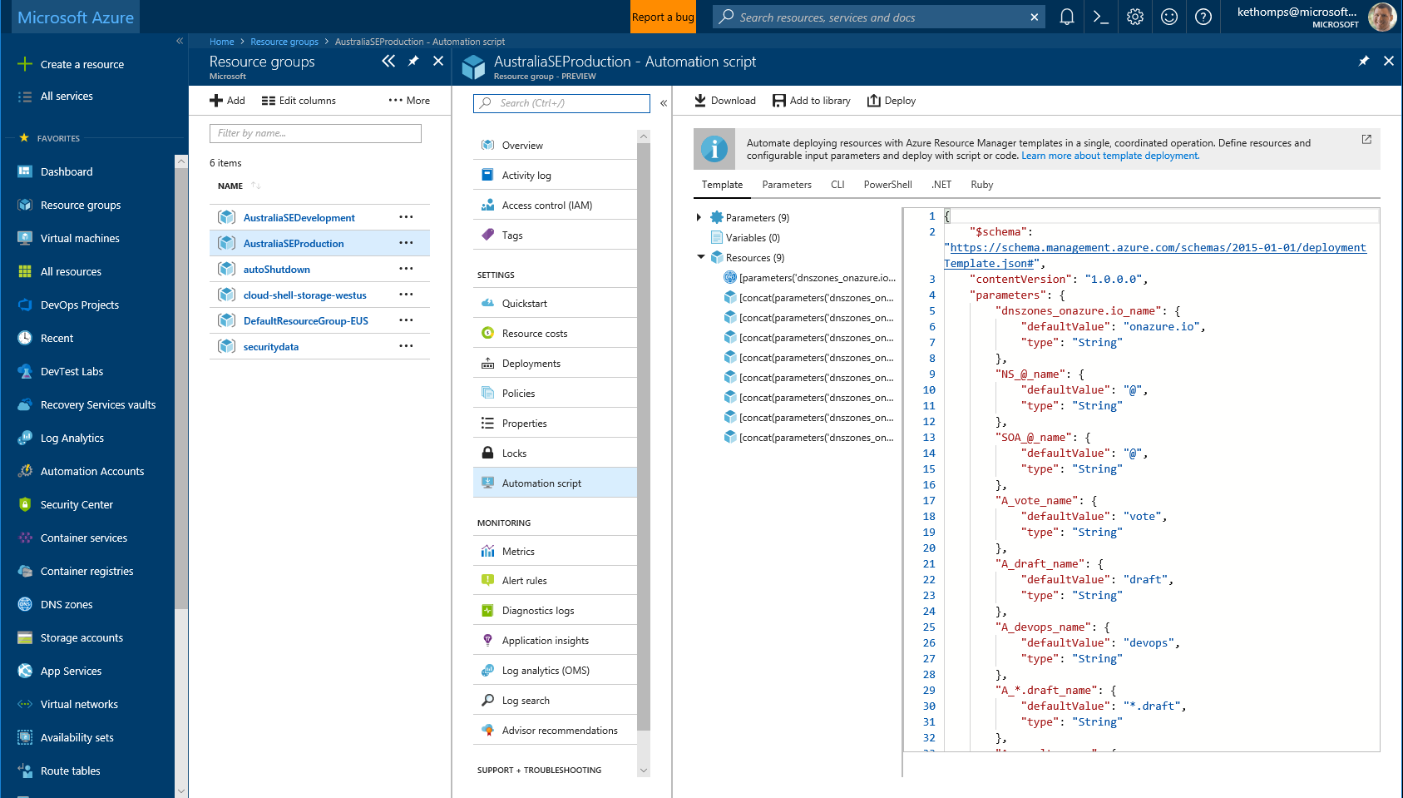
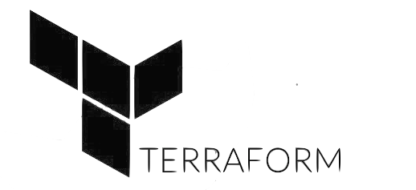

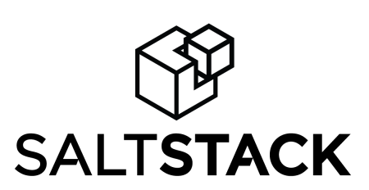
Infrastructure and Configuration as Code
Azure Resource Manager, Automation & 3rd Party Integrations
Infrastructure as Code, built-in
Azure Config & Automation
Support for 3rd party and OSS tooling such as Terraform, Ansible, Chef, Puppet & SaltStack
Notes:
Deploy repeatedly & reliably using Infrastructure as Code
Azure Resource Manager provides these capabilities for Azure out of the box, and works across Azure as well as Azure Stack
But if you’re already using 3rd party tools such as Terraform, Ansible, Chef, Puppet or SaltStack – we support those too!

Slide 27
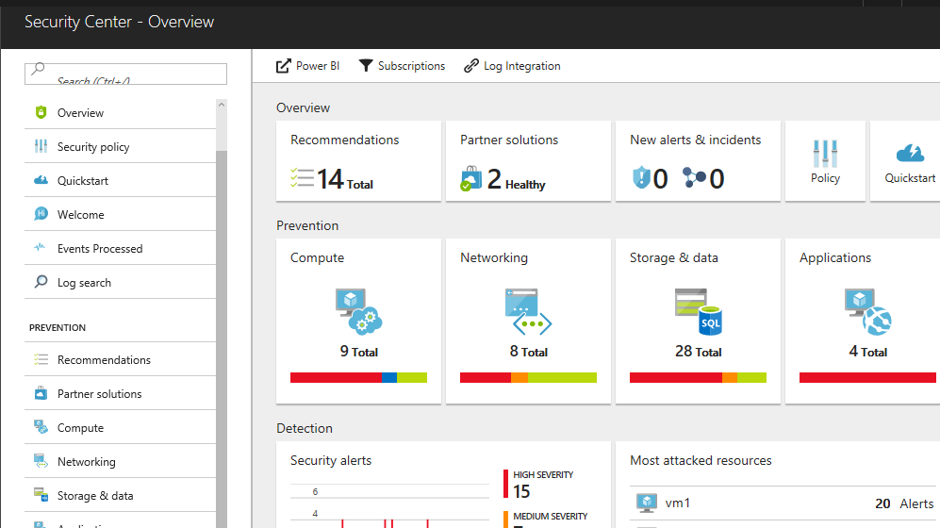
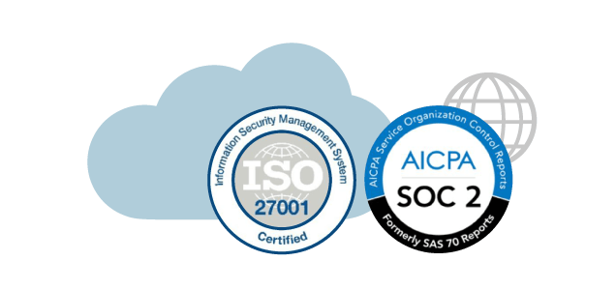
Continuous Security
Azure Security Center
Gain full visibility and control of your cloud security state
Leverage ML to Proactively identify and mitigate risks to reduce exposure to attacks
Quickly detect and respond to threats with advanced analytics
Notes:
Just because you’re moving fast, doesn’t mean you have to lose control – even if you have some Shadow-Ops happening
Azure security gives you visibility and control of your entire cloud security state
Using analytics to provide pro-active recommendations across both Windows and Linux
Leverage services like Azure Event Viewer also to track access, see who change what and when.
------ (additional product context) ------
Secure your cloud resources with Azure Security Center
With Azure Security Center you can gain full visibility and control of your cloud security state with a single, unified view:
Collect security data from multiple sources: Collect, search, and analyze security data from a variety of sources, including connected partner solutions like network firewalls and other Microsoft services.
Integration with existing security workflows: Access, integrate, and analyze security information using REST APIs to connect existing tools and processes.
Easily onboard cloud resources: Keep pace with rapidly changing cloud workloads. Automatically discover and onboard new resources created in your Azure subscriptions.
Continuous security assessment: monitor the security of virtual machines, networks, and Azure services using hundreds of built-in security assessments or create your own.
Built-in dashboards provide instant insights into security issues that require attention.
Centralized policy management: Ensure compliance with company or regulatory security requirements by centrally managing security policies across all your cloud workloads.
Compliance reporting: Use security data and insights to demonstrate compliance and easily generate evidence for auditors.
(If asked whether Azure Security Center supports hybrid workloads, the answer is yes: manage security across all your hybrid cloud workloads – on-premises, Azure, and other cloud platforms – in one console.)
You can also identify and mitigate risks proactively to reduce your exposure to security threats:
Proactive security assessment: Identify software and configurations that are vulnerable to attack.
Actionable recommendations: Remediate security vulnerabilities before they can be exploited by attackers with prioritized, actionable security recommendations and built-in automation playbooks.
Adaptive application controls: Block malware and other unwanted applications by applying whitelisting recommendations adapted to your specific workloads and powered by machine learning.
Controlled network access: Reduce the network attack surface with just-in-time, controlled access to management ports on Azure VMs, drastically reducing exposure to brute force and other network attacks.
Azure Security Center has robust capabilities to prevent attacks. When threats do happen, Security Center can quickly detect and respond to threats with advanced analytics and Microsoft Intelligent Security Graph.
Industry’s most extensive threat intelligence: Tap into the Microsoft Intelligent Security Graph, which uses trillions of signals from Microsoft services and systems around the globe to identify new and evolving threats.
Advanced threat detection: Use built-in behavioral analytics and machine learning to identify attacks and zero-day exploits. Monitor networks, machines, and cloud services for known attack patterns and post-breach activity.
Prioritized alerts and incidents: Focus on the most critical threats first with prioritized security alerts and incidents that map alerts of different types into a single attack campaign. Create your own custom security alerts as well.
Streamlined investigation: Quickly assess the scope and impact of an attack with a visual, interactive experience. Use predefined or ad hoc queries for deeper exploration of security data.
Contextual threat intelligence: Visualize the source of attacks on an interactive world map. Use built-in threat intelligence reports to gain valuable insight into the techniques and objectives of known malicious actors.
At Microsoft, we analyze 300 billion user authentications and check 200 billion emails for spam and malware monthly. We also have unprecedented visibility into cloud infrastructure choices, platforms and the activity therein. Such visibility has no precedent in the on-premises world.

Slide 28
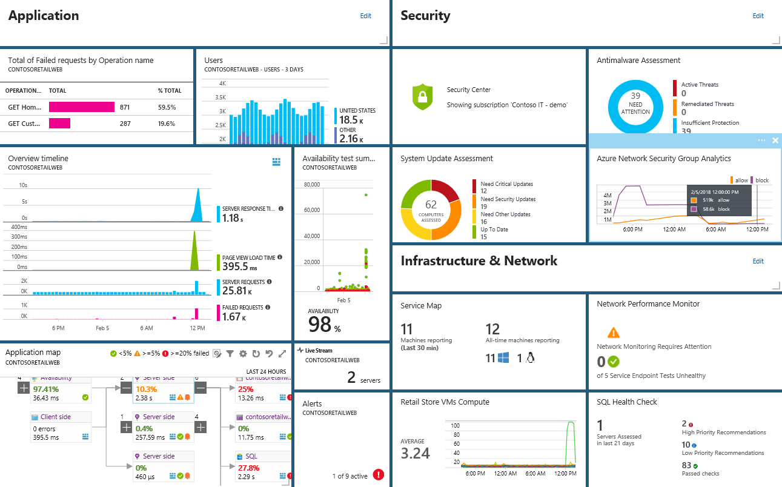
Smarter Insights, Faster
Azure Monitor, Application Insights & Log Analytics
Pre-defined solutions with smart thresholds
Visualize data in intuitive and customizable dashboards
Separate the signal from the noise and accelerate root-cause analysis
Integrate your existing processes & tools like Service Now
Notes:
Azure’s monitoring solutions provide pre-defined solutions with smart thresholds and intuitive dashboards so you can start getting insights straight away
Azure Monitor provides metrics for all Azure infrastructure, building upon that you can leverage both Log Analytics and Application Insights to gain greater insights into your Infrastructure and Applications respectively – leveraging Azure to simplify this into standardized dashboards for both your Developer and your Operations teams
Spend less time separating the signal from the noise and accelerate you root cause analysis
You can also automate and integrate into your existing service desk platforms such as Service Now
------ (additional product context) ------
Monitor your cloud health with Log Analytics
Collect and store your data from any source
Easily collect, store, and analyze your systems and operational data from any source, both on-premises and in the cloud.
Collect data from a wide range of sources including virtual machines, storage accounts, activity logs, Windows, Linux Servers, Java, .NET, legacy and modern apps.
Centrally store activity logs, network logs, infrastructure metrics, app data points, diagnostics logs and alerts.
Gain deep operational insights
Understand CPU disk and memory utilization for your virtual machines.
Get a comprehensive view of applications and network dependencies across multiple virtual machines to perform root-cause analysis more quickly.
Track configuration changes, system updates, and malware status to improve security & compliance.
Visualize data in intuitive and customizable dashboards.
Find the information you need quickly using interactive queries and full-text search.
Detect, diagnose and fix issues quickly
Get notifications and alerts with rich diagnostic information so you can always stay on top of the issues.
Separate the signal from the noise and accelerate root-cause analysis across platforms using advanced analytics including machine learning algorithms.
Automate the implementation of recommended fixes so you can address issues quickly.
Integrate with customer service systems such as your ticketing tool to speed up implementation of fixes.

Slide 29




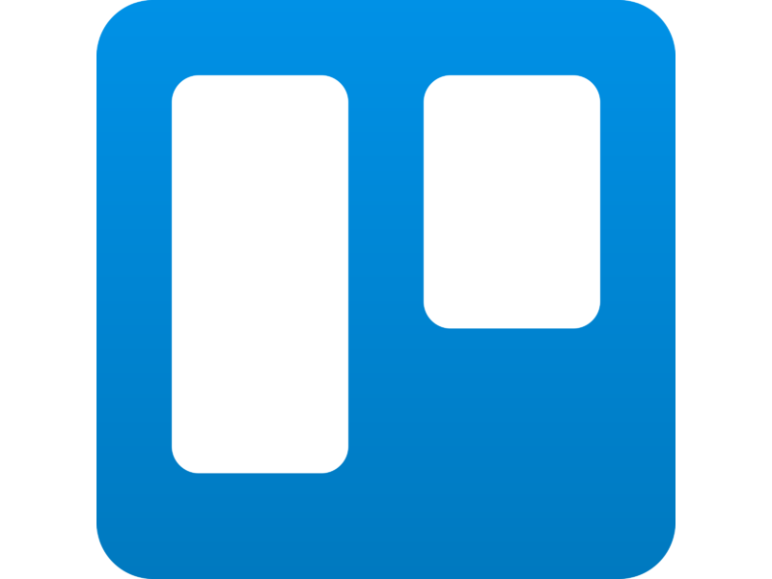
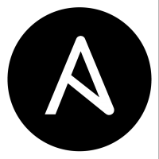

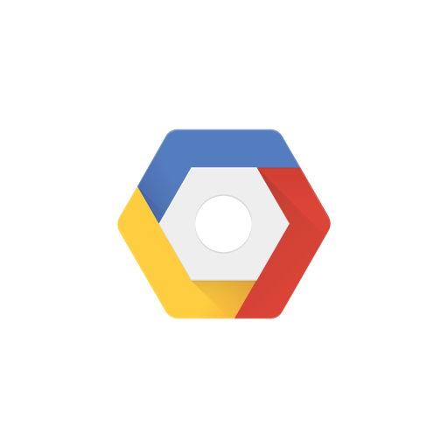

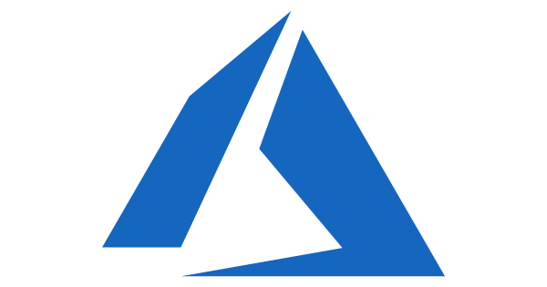

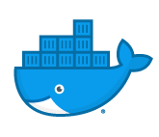
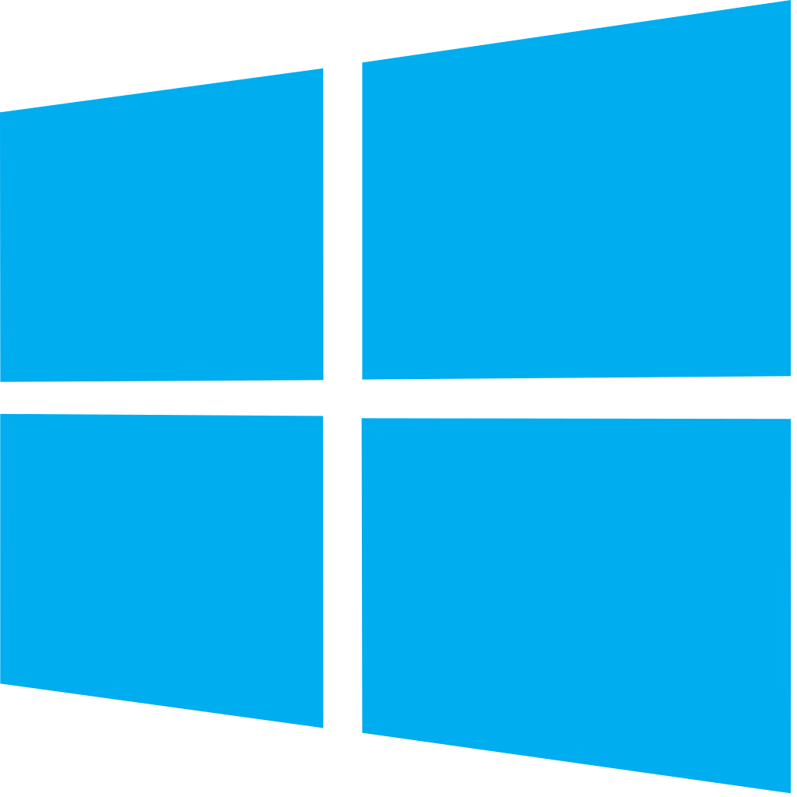


Azure DevOps: Choose the tools and clouds you love
Azure DevOps lets developers choose the tools that are right for them
Mix and match to create workflows with tools from Microsoft, open source or your favorite 3rd party tools
Target any cloud, on-prem or both and deploy to the servers you need

Slide 30




Azure DevOps supports small teams to largest enterprises
Instead of telling people to wait for 6 months for a new feature, we can give it to them in a few weeks…Our 2800 worldwide developers can use the same backlog, user stories and tests whether they’re on Windows or Linux… building for iOS or Android.
Speed is gained in moving to the PaaS offering of Azure DevOps. PaaS provides regularly released features and a future-proof capability, eliminating the need for Accenture to maintain infrastructure and go through upgrade cycles.
“
“
”
”
Microsoft made it really easy to break outside the silos… and tie the DevOps process into the fulfilment of business process. Without the tools that we have today, we would not be successful.
Branches sync 500 percent faster. Builds are 400 percent faster, with the typically six-hour process reduced to 90 minutes. We (now have) a highly streamlined process that operates with a few button clicks—and one-button deployment.
“
“
”
”

Slide 31
DevOps at Microsoft
Azure DevOps is the toolchain of choice for Microsoft engineering with over 90,000 internal users
➔
https://aka.ms/DevOpsAtMicrosoft
372k
Pull Requests per month
4.4m
Builds per month
5m
Work items viewed per day
78,000
Deployments per day
2m
Git commits per month
500m Test executions per day
500k
Work items updated per day
Data: Internal Microsoft engineering system activity, August 2018
Notes:
Enterprise scale

Slide 32
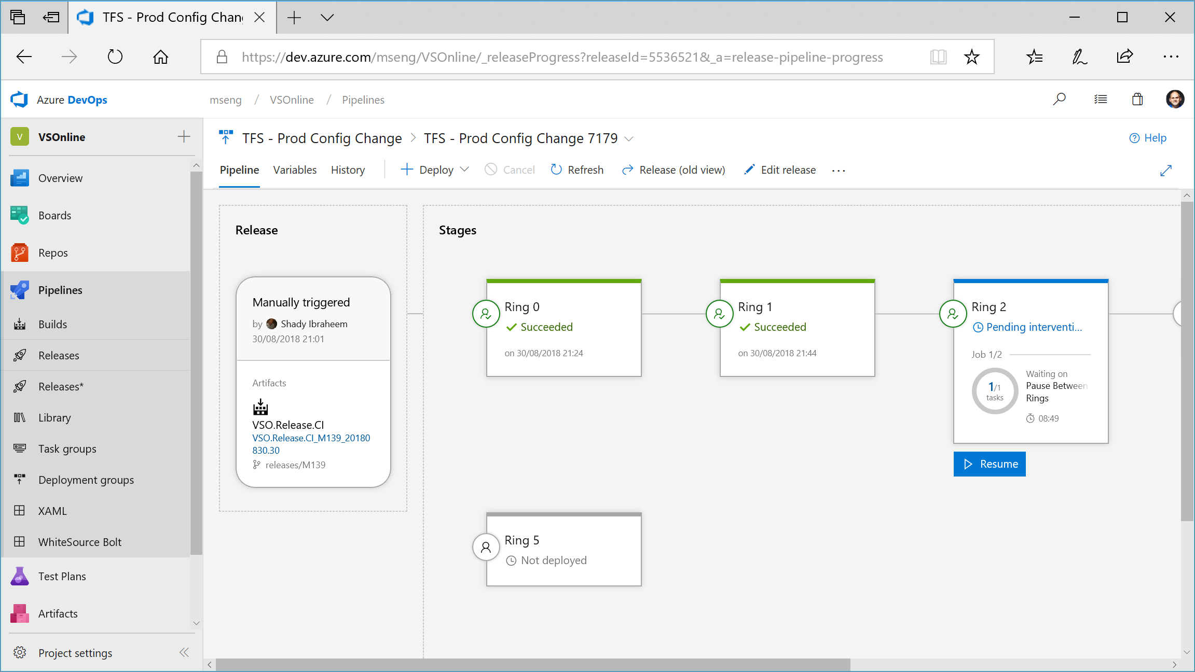

Slide 33
Changes for existing VSTS / TFS customers
The same functionality you know and love today, with greater openness, flexibility and focus
Existing Accounts
Existing https://contoso.visualstudio.com URL continues to work. https://dev.azure.com/contoso available for opt-in.
New UI opt-in per user as preview feature. Will start advertising new UI once feedback from new accounts and early adopters has been incorporated.
Can disable services on a per project basis for new UI
New Azure branding in communications and documentation (emails, alerts etc).
Websites and documentation will move from Visual Studio to Azure based locations (with redirects in place).
Redirects available for some time.
TFS will remain the on-premises brand until the next major version in 2019. The new UI will be enabled in that release.
Existing TFS branded information and downloads remain in Visual Studio locations until next release.
Pricing
Public project usage is now free.
The free tier for Pipelines now includes 1,800 minutes per month, up from 240.
Pipelines can be used independently from Repos — so if you are only using Pipelines and your repos are hosted on GitHub you don’t need to pay for Repos or Boards (Basic) users.
New Accounts
https://dev.azure.com/contoso based URL.
New navigation & branding by default.
Notes:
The functionality you know and love today remains and will continue to be actively expanded on at the same rapid cadence as you are used to. The services will get even more open and extensible with more choice to your workflows. You will be able to move to the new UI when it works for you and your team
Existing Accounts
https://myorg.visualstudio.com continues to work but new https://dev.azure.com/myOrg address also available for opt-in.
New UI opt-in per user. Will start advertising new UI once feedback from new accounts and early adopters has been incorporated.
Can disable services on a per project basis
New Azure branding in communications and documentation (emails, alerts etc).
Websites and documentation will move from Visual Studio to Azure based locations (with redirects in place).
Redirects available for some time.
TFS will remain the on-premises brand until we ship the next major version in 2019. Existing TFS branded information and downloads remain in Visual Studio locations until next release. The new UI will be available in that release.
Pricing
A few key changes:
Public project usage is free.
The free tier for Pipelines now includes 1,800 minutes per month, up from 240.
Pipelines can be used independently from Repos—so if your repos are hosted on GitHub you don’t need to pay for Repos & Boards (Basic) for your users.
New Accounts
https://dev.azure.com/myOrg based URL.
New UI by default.

Slide 34
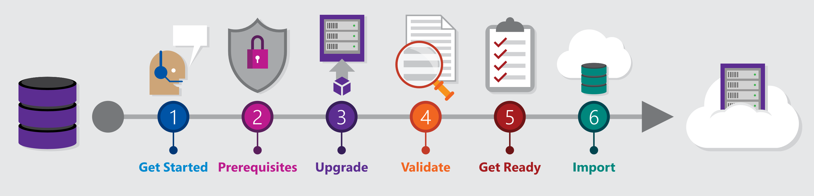
Migrating from TFS to Azure DevOps
Move from Team Foundation Server to Azure DevOps and bring your data along
Benefits of Cloud Hosted Azure DevOps Services
Global availability
Hosted and maintained by Microsoft with 99.9% uptime guarantee and 24x7 support
Immediate access to latest features
Simplified deployment to Azure
TFS Import Service
Fully supported high fidelity migration path
Trusted by many large enterprises
Now faster and easier to use
➔
https://aka.ms/tfsimport

Slide 35





Azure DevOps
Plan smarter, collaborate better, and ship faster with a set of modern dev services
Any developer, any platform, any cloud. Full support for hybrid cloud, on-premises & containers.
Use all the Azure DevOps services or choose just what you need to complement your existing workflows
Best in class builds for open source. Free unlimited build minutes for public projects and up to 10 free concurrent jobs across Windows, Linux and macOS
Get started for free for small teams, scales to support the largest enterprises
Azure Boards
Azure Repos
Azure Pipelines
Azure Test Plans
Azure Artifacts
Start free today
➔
https://azure.com/devops

Slide 36
Azure DevOps Services Pricing
Open Source Projects
Small Teams
Teams of any size
Free
Unlimited users and build time
Azure Pipelines: 10 parallel jobs with unlimited minutes for CI/CD
Azure Boards: Work item tracking and Kanban boards
Azure Repos: Unlimited public Git repos
Free
Start free with up to 5 users
Azure Pipelines: Run 1 Microsoft-hosted job for 1,800 minutes per month and 1 self-hosted job for any amount of time
Azure Boards: Work item tracking and Kanban boards
Azure Repos: Unlimited public Git repos
Azure Artifacts: package management
Unlimited stakeholders
Starts at $6 per user, per month for Boards & Repos*
Easy pricing that grows with your team
Azure Pipelines: Run 1 Microsoft-hosted job for 1,800 minutes per month and 1 self-hosted job for any amount of time
Azure Boards: Work item tracking and Kanban boards
Azure Repos: Unlimited public Git repos
Azure Artifacts: package management
Unlimited stakeholders
Boards & Repos included for Visual Studio subscribers
*
https://azure.com/pricing/details/devops/
5 Boards & Repos users and 5 Artifacts users free. Pipelines with unlimited minutes, Test Plans users and additional Artifacts users also available. Please see the Azure pricing calculator for details.
➔

Slide 37

Thank You

Slide 39
Deck Resources
Azure DevOps PowerPoint Template
Spare Slides
Fonts
Brand Colors
Common Icons (SVG format)

Slide 40
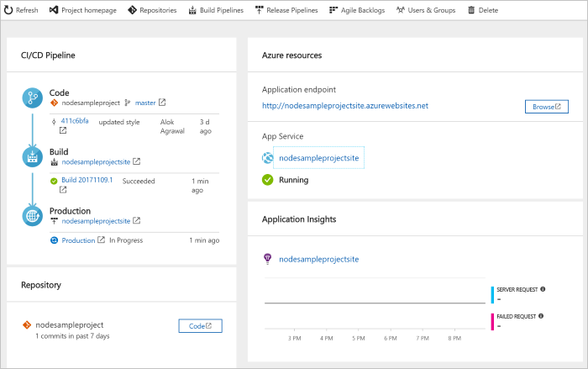
DevOps Pipelines in Minutes
Azure DevOps Projects
Create a full DevOps pipeline with 3 easy steps from the Azure Portal
Start with a Git repo and any source language
Web apps, Kubernates, soon VMs and more.
Customize, extend and scale when needed.
Notes:
Moving from the developer environment, Azure also makes deploying, or integrating existing, DevOps pipelines as fast as possible
Azure DevOps Projects is the quickest way to get started with DevOps on Azure for people who know about DevOps but are just starting or want a quick way to create a basic pipeline to play with or build upon.
DevOps projects creates a basic, complete CI/CD pipeline in Azure which can later be extended and customized outside in Azure Pipelines
Although DevOps Projects builds a DevOps pipeline on Azure it allows for any easy “Getting started” experience with Azure Pipelines which can then be applied to hybrid and on-prem scenarios with Azure Pipelines which can target any platform or with Azure DevOps Server which can be installed on prem.

Slide 41


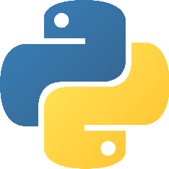
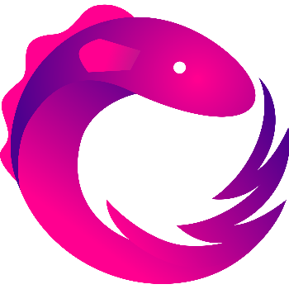
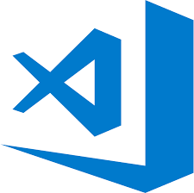
Early adopters
GitHub projects already powered by Azure Pipelines for CI
atom/atom
python/cpython
dotnet/reactive
microsoft/vscode

Slide 42
Global Reach
Azure DevOps has more global regions than any other cloud provider

